Slide 1
Punctuation Notes
Commas to set off sentence openers

Slide 2
Dependent and Independent
Dependent-
A baby depends on his mother to take care of him. He cannot be left alone.
A dependent clause also cannot be left alone because it is not a complete sentence.
Independent-
A college student feels independent because they are living on their own.
An independent clause is a complete sentence and can be left on its own. It has a subject and a verb (predicate).

Slide 3
Practice: Dependent or Independent?
If it is dependent, cradle your arms as if you are holding a baby.
If it is independent, put your fist in the air as if you are declaring your freedom.

Slide 4
Dependent or Independent?
You should call your mother

Slide 5
Dependent or Independent?
You should call your mother
You should call your mother
→ independent clause

Slide 6
Dependent or Independent?
On the train

Slide 7
Dependent or Independent
On the train
No subject, no verb= dependent clause

Slide 8
Dependent or Independent?
He fights

Slide 9
Dependent or Independent?
He fights
S V
→ independent clause

Slide 10
Dependent or Independent?
Winter is here

Slide 11
Dependent or Independent?
Winter is here S V
→ independent clause

Slide 12
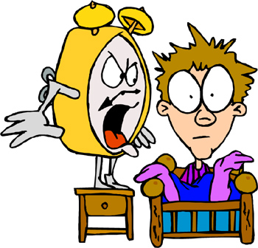
Dependent or Independent?
Waking in the morning

Slide 13
Dependent or Independent?
Waking in the morning
No subject & verb= dependent clause

Slide 14
Dependent or Independent?
Over the river, through the woods, and beyond the mountains

Slide 15
Dependent or Independent?
Over the river, through the woods, and beyond the mountains
No subject & verb= dependent clause

Slide 16
Dependent or Independent?
cats are evil

Slide 17
Dependent or Independent?
cats are evil
→ independent clause

Slide 18
An opener/beginner is:
A dependent clause at the beginning of a sentence.
It is ALWAYS set off by commas.
Opener (dependent) , sentence (independent).
Example:
Through the haystack, the mouse ran.

Slide 19
Use commas to set off a prepositional phrase sentence opener
What is a prepositional phrase?
A group of words that starts with a preposition and ends with a noun or pronoun.
A prepositional phrase is NOT a complete sentence.
[through the haystack]
[around the corner]
[during the game]

Slide 20
Use commas to set off a participial phrase sentence opener
What is a participial phrase?
A group of words that starts with a “ing” or “ed” verb and ends with a noun.
A participial phrase is NOT a complete sentence.
Tired of running
Blinking in the bright sunlight

Slide 21
Review
An opener has the following format:
Opener (dependent) , sentence (independent).

