Slide 2
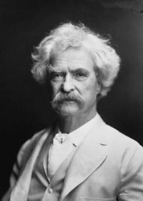
“The difference between the right word and the almost right word is the difference between lightning and a lightning bug.” ― Mark Twain, The Wit and Wisdom of Mark Twain

Slide 4
Your = possessive/ownership Loose= not tight

Slide 5
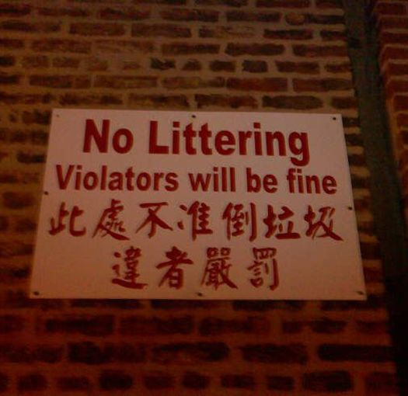
Violators will be fine? Let’s litter!

Slide 6
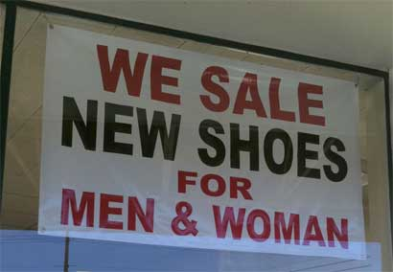
Sell (verb)- Act of exchanging goods for money. Sale=an event for the rapid disposal of goods at reduced prices

Slide 7
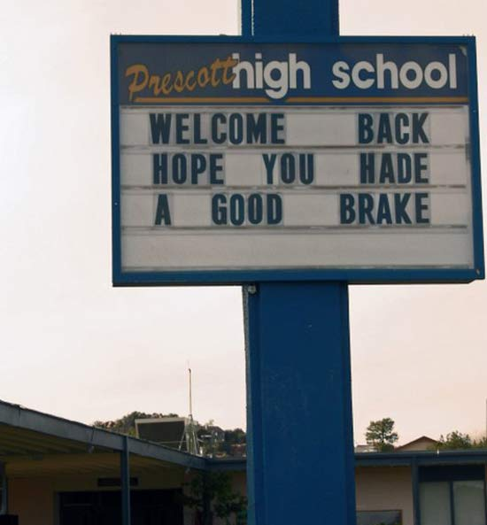
break- A pause in activity brake- A device for slowing or stopping a vehicle

Slide 8
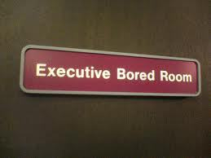
bored- feeling weary due to lack of interest

Slide 9
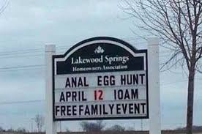

Slide 10
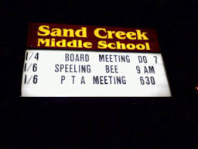
speel- to climb

Slide 11
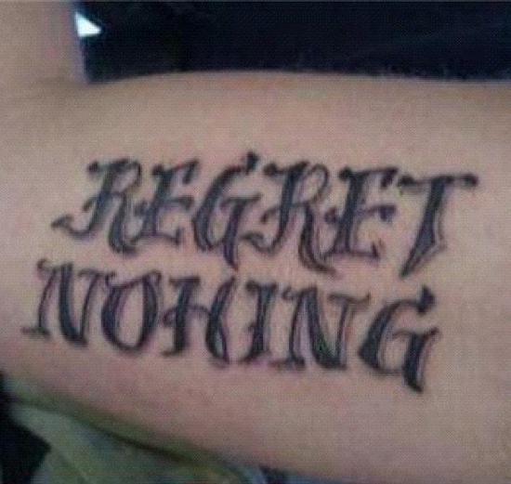
… or just this tattoo?

Slide 12
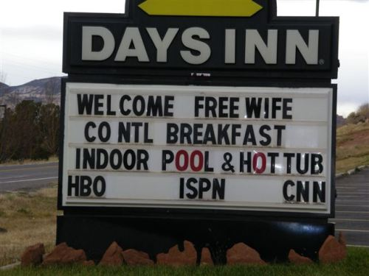
Free wife? They got it all here!

Slide 13
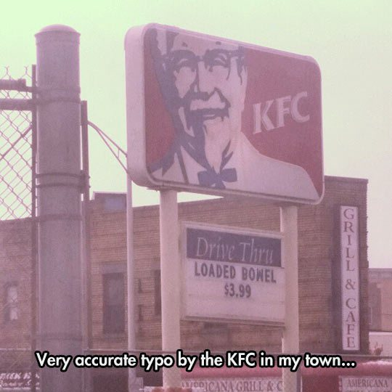
bowel- your intestines…

Slide 14
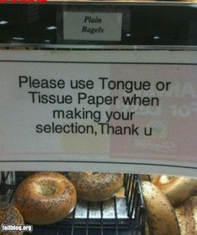

Slide 15
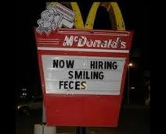

Slide 17
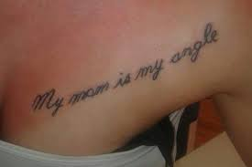

Slide 18
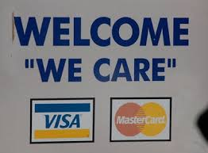
Do you really care? You’re just saying that, aren’t you?

Slide 19
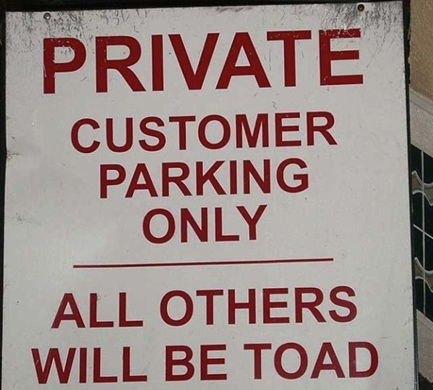
toad- amphibian towed- past tense of ‘tow’

Slide 20
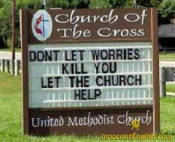
Hmmmm…

Slide 21
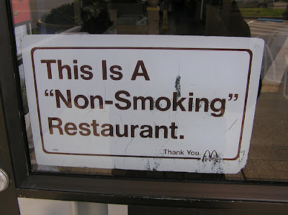

Slide 23
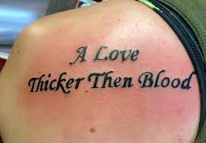
Then- happen next Than- comparison

Slide 25
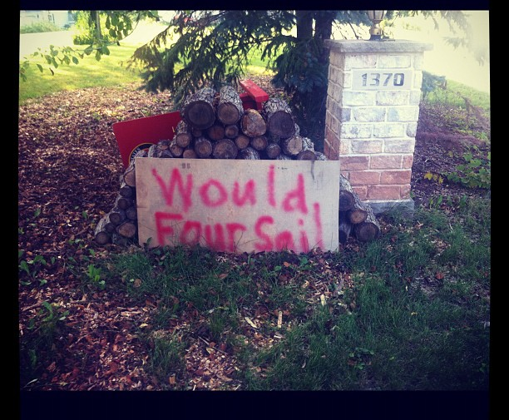
would- desire or intent four- 4 sail- fabric for a boat; to move across water

Slide 26
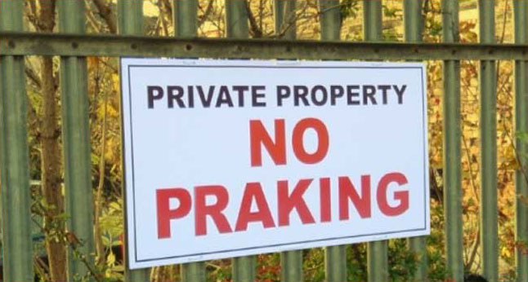
Prak- overcome with religious joy

Slide 27
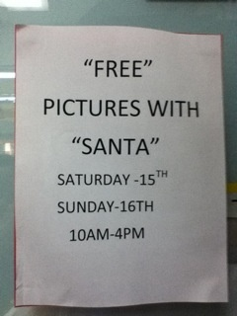
Is it really free? Is it really Santa?

Slide 28
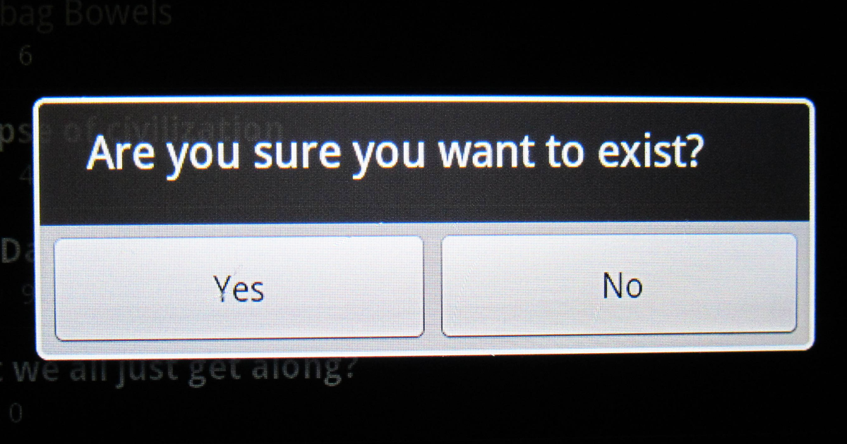
Hmmm…. Good question

Slide 29
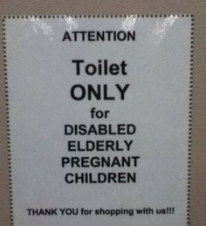
Hmm… a disabled, elderly, pregnant child.

Slide 30
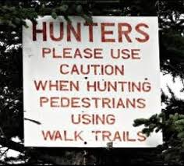
Hunting humans….

Slide 31
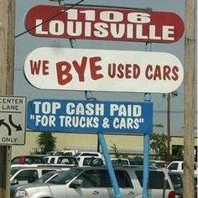
We bye? You leaving?

Slide 32
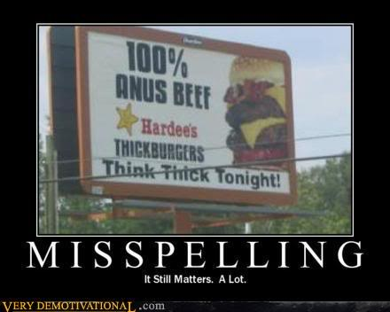
I’ll pass, thanks…

Slide 33
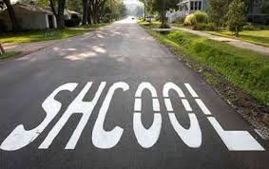
Shhh… it’s cool ! Right?

Slide 34
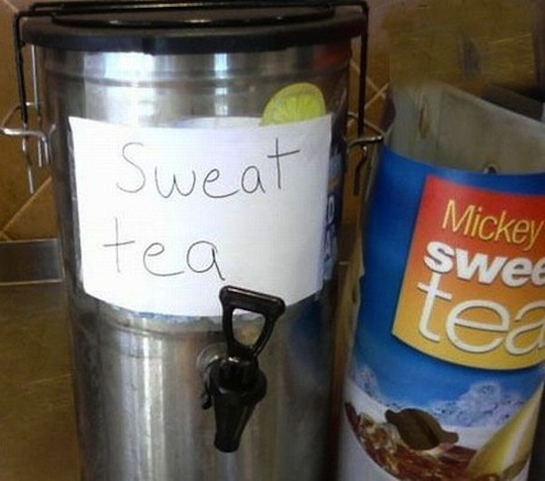
I’ll pass…

Slide 35
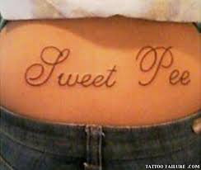
Remember…tats are forever

Slide 36
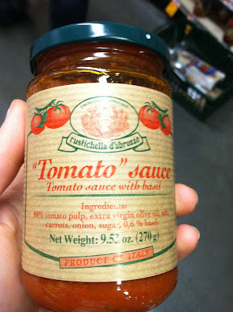
Is it really tomatoes?

Slide 37
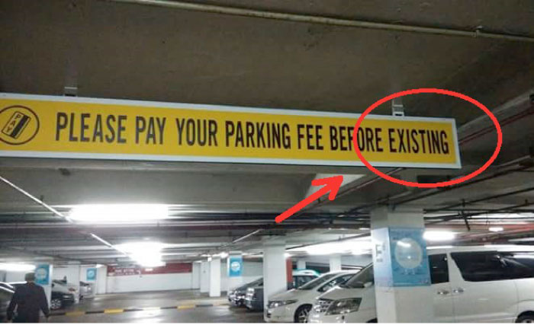

Slide 38
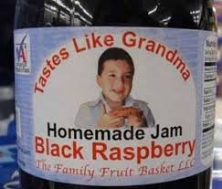
I’ll pass…

Slide 39
I’ll find fifty bucks? Score!

Slide 40
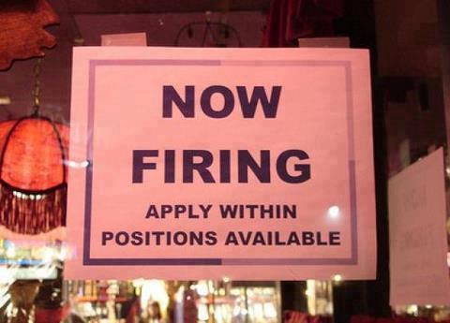
One letter makes all the difference

Slide 41
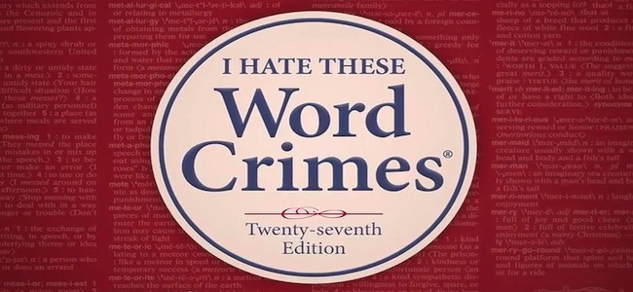
Don’t make Word Crimes!

