Slide 1
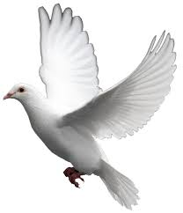
Symbolism

Slide 2
What is a symbol?
A symbol is an object that stands for or represents another object or idea.

Slide 3
Do you recognize any of the following symbols? Do you know what they stand for?

Slide 4
Do you recognize any of the following symbols? Do you know what they stand for?

Slide 5
Do you recognize any of the following symbols? Do you know what they stand for?

Slide 6
Do you recognize any of the following symbols? Do you know what they stand for?

Slide 7
Do you recognize any of the following symbols? Do you know what they stand for?

Slide 8
Can you figure out symbolism in color? Do you know what each color can represent?
Red
White
Black
Blue

Slide 9
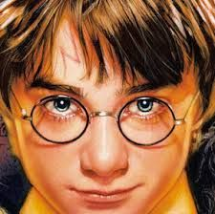
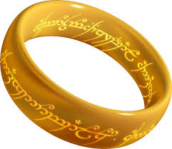
Symbols in Literature
In literature, symbols can be anything, even common objects that mean something beyond themselves.
greed? temptation?
Love? Bravery? Hope?
Hope?

Slide 10
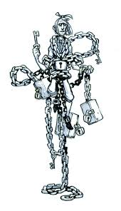
the chains and how they were made
“I wear the chain I forged in life. I made it link my link, and yard by yard; I girded it on of my own free will, and of my own free will I wore it.”
“Would you know the weight and length of the strong coil you bear yourself? It was full as heavy and as long as this, seven Christmas Eves ago. You have labored on it, since. It is a ponderous chain!”

Slide 11
What is symbolic with Marley?
cash boxes: cash boxes keep cash and symbolize the cash accumulated
keys and padlocks: used to lock the cash boxes symbolizing the desire to keep the money from others.
ledgers: a record of debts symbolizing the need to keep track of everyone who owes him money
deeds: a paper that shows the ownership of property symbolizing the desire to accumulate wealth
heavy purses: used to hold money symbolizing the greed of Marley
chains: the chains attach all of the these items to Marley, and he must carry them through eternity as punishment for choosing wealth over his responsibility to nurture mankind. Every cruel deed created another link in the chain.

Slide 12
https://www.youtube.com/watch?v=69A6xyXGC-M

