Slide 1
Just Be You
Ashley O.

Slide 2
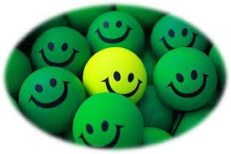
why would you want to be someone else
when you could be
better
by being yourself

Slide 3
impress and
trying to
live
the
of another
life
is a mighty
mistake
nothing more than a fake

Slide 4
just
be
you

Slide 5
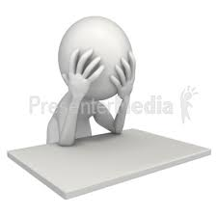
be that person you always
hid
and
doubted
is self-dissatisfaction
and
frustration
worth those few untrue friends

Slide 6
be
brave
and like a wild wave
that can never be tamed
carve your own path
on the shoreline

Slide 7
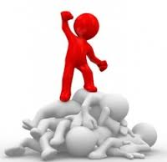
don’t
fear
others’ criticism
and protrude the real you

Slide 8
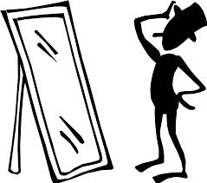
go
to a mirror
and it will tell you
unique
how
you can be
if you

Slide 9
just
be
you

Slide 10
beauty
is on the inside
show the terrific truth

Slide 11
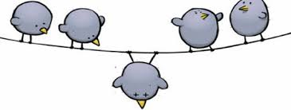
this is
exactly
who you are suppose to be
tell
yourself it was worth it
and be nothing

Slide 12
but
you

