Slide 1
8th Grade Language Arts:
Rules and Procedures
Butterfield, Barber, Nye, Tohara

Slide 3
Believe it or not, working hard in 8th grade is important!
You will take 8th grade habits to 9th grade. Figure out
school this
year!!

Slide 4
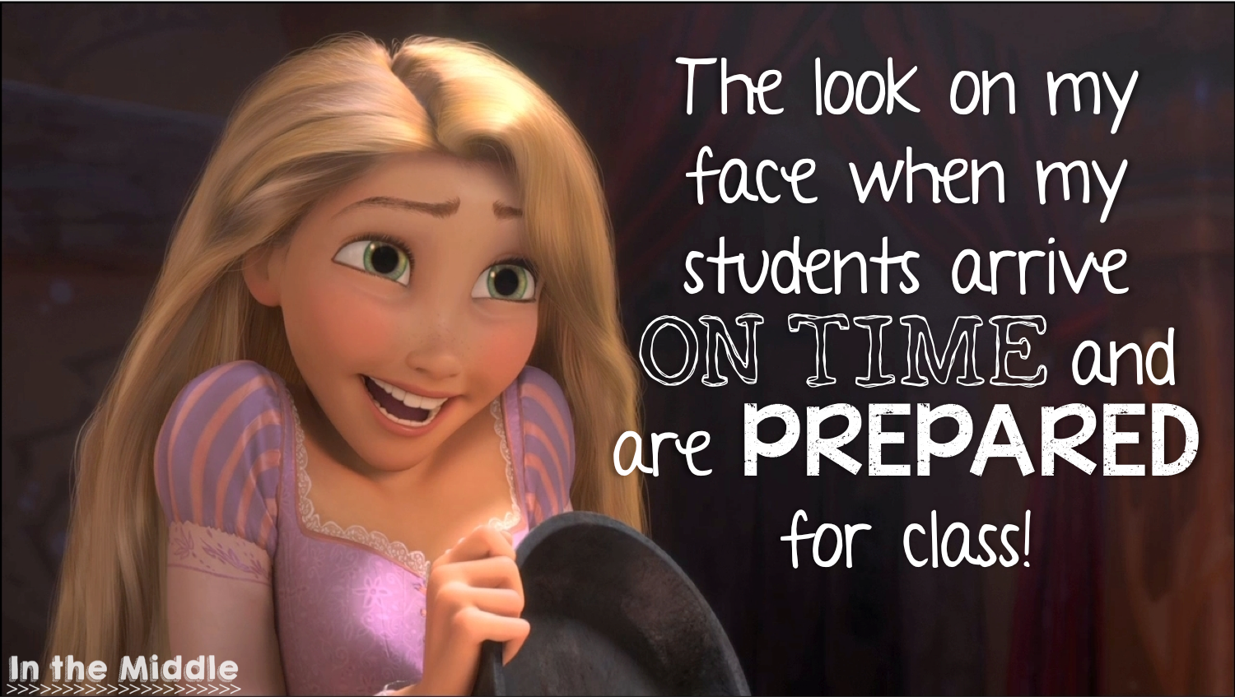
Rule #1: Be Prompt
Be in assigned seat BEFORE the bell rings.
Turn quality assignments in on time.
Find materials and assignments quickly.

Slide 5
Rule #2: Be Prepared
Bring binder and materials daily.
Keep track of due dates.
Study for quizzes and tests.

Slide 6
Make a homework plan!

Slide 7
Don’t leave your scores to chance. Study for quizzes and tests.

Slide 8
Rule #3: Pay Attention
Don't sleep in class.
Don’t text, write notes, or work on assignments for other classes.
Follow along with the class.

Slide 9
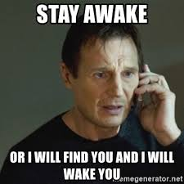
We all get tired! Try to stay awake and do your best!

Slide 10
Rule #4: Participate
Raise your hand to make a comment.
NO BLURTING OUT!
One person talks at a time.
Contribute to class discussions.
Be an active participant in partner or group work.
Keep comments on topic.

Slide 11
I will call on all students, even if you don’t raise your hand.

Slide 12
Rule #5: Practice
Use class time to
finish assignments.
Complete unfinished
assignments at
home.
Review concepts
taught in class at
home.

Slide 13
Classroom consequences:
Rewards:
praise
treats
academic success
class rewards
positive parent contact
Interventions:
verbal warning
move seats
removal from class
lower citizenship grade
negative parent contact
referral to assistant principal

Slide 14
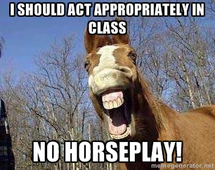
Entering the Classroom
Walk in quickly and quietly.
(no shouting or horse play)
Sharpen pencil if necessary.
Get class notebook
if needed.
Be IN your assigned seat
BEFORE the bell.
Begin working on the starter.

Slide 15
What should I have daily in class?
three ring binder (with folders)
pencil pouch (with pencils, colored pencils, pencil sharpener, highlighter, and sticky notes)
class notebook
(get from bins
if requested/note
will be on door)

Slide 16
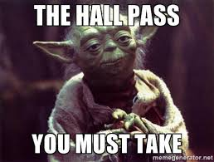
Hall Passes
Each quarter you will receive two hall passes.
Hall passes may be used to use the restroom, go to your locker, get a drink, etc.
You may not use hall passes during instructional time or during testing.
If you don’t use hall passes, you turn them in at the end of each quarter as a raffle ticket.

Slide 17
Food in the classroom
NUT FREE ZONE. Do not bring anything with nuts in it into the classroom.
Food is NOT permitted in the classroom unless you have special permission.
You may eat the treats that I provide in class.
You may bring a bottle of water to class but no soda, gatorade, flavored water, etc.
Gum is permitted as long as it stays in your mouth and out of sight. If I see you passing it out, I will take it away.
All wrappers go in the GARBAGE CAN, NOT THE RECYCLE BIN.

Slide 18
The Recycle Bin
The recycle bin is not a garbage can. No candy wrappers, food, etc.
Use the recycle bin to recycle unwanted papers and plastic water bottles.
Discard papers as they are. DO NOT CRUMPLE THEM UP. This takes up more space and the bin has to be emptied more frequently.

Slide 19
When can I sharpen my pencil?
The best time to sharpen pencils is during your five minute break.
Please keep extras in your pencil pouch.
NEVER SHARPEN YOUR PENCIL DURING INSTRUCTIONAL TIME. (That’s why we ask you to have a hand-held one.)
If you need to sharpen pencil during class, please wait until work/practice
time.

Slide 20
Total Quality Work
All work must have first AND last name, date, and class period in the upper right-hand corner of every assignment.
All work should be submitted on regular size loose leaf paper or plain white paper (if printed from a computer).
If work submitted is incomplete or completed incorrectly, you will receive a TQW stamp. When this happens, you must either finish the assignment or redo it correctly.

Slide 21
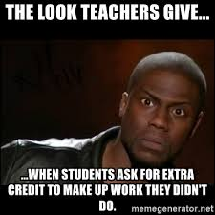
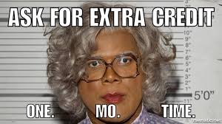
Can I do extra credit?
NO!!!!!!!!!!
Complete assigned work.

Slide 22
Where do I turn in homework?
Never give homework directly to me.
Use class period baskets.
Put in the correct period!
Late work goes in the late basket regardless of which period you are in.
Late work will ALWAYS be graded last! If an assignment is turned in late, it will be entered late. (This means you will have a zero until I have time to grade it.)
Papers without names go in no name basket

Slide 23
What if I am absent?
Look on the absent work calendar for what you missed.
Pick up missing work.
Ask a classmate about what you missed.
See me for questions or clarification of assignment.
Write “absent” on work submitted while you were gone and turn in to “late” basket

Slide 24
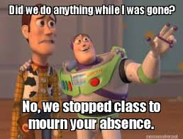

Slide 25
Other classroom expectations:
Only appropriate/respectful language permitted in this classroom. No curse words or “potty mouth” talk.
Only touch items that belong to you. No hiding binders or borrowing things without asking.
Phones/iPods etc. are only used with permission. School policy enforced.
No put downs or rude comments will be tolerated!

Slide 26
At the end of class...
We work until the bell rings. DO NOT pack up early or watch the clock.
If you borrowed books or supplies from me, please return them to the correct place.
Clean up after yourself.
The bell does not excuse you.
I do!!!
Stay in your seat until the bell.
Push in your chair before
leaving.

